Slide 1
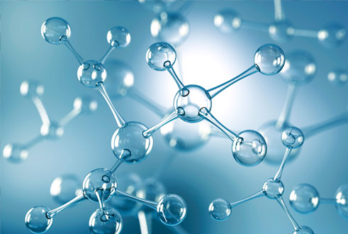
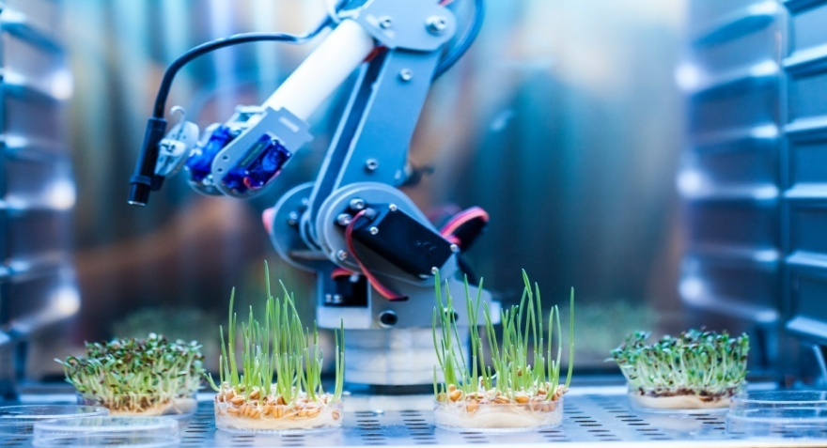
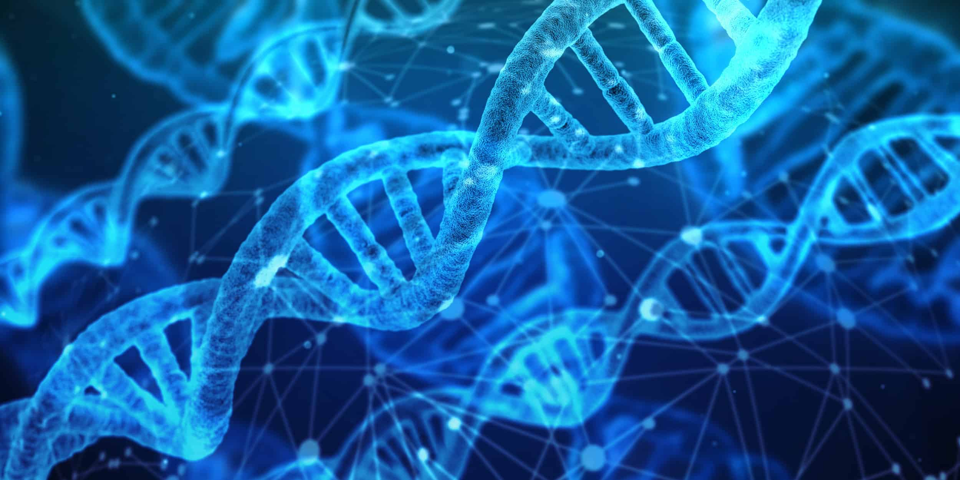
BIOTECHNOLOGY

Slide 2
ABSTRACT
Biotechnology is the development and utilization of biological forms , products and processing for obtaining maximum benefits to man and other forms of life .
It is the application of scientific and engineering principle to processing of materials by biological agents to provide goods and service to human welfare.
It uses scientific principles of microbiology , genetics biochemistry , chemical engineering , statics , computers etc.
As biotechnology has number of applications especially in Medical field , agriculture , gene therapy , vaccine production etc.
But it has some disadvantages too as it effects the environment , human health etc.

Slide 3
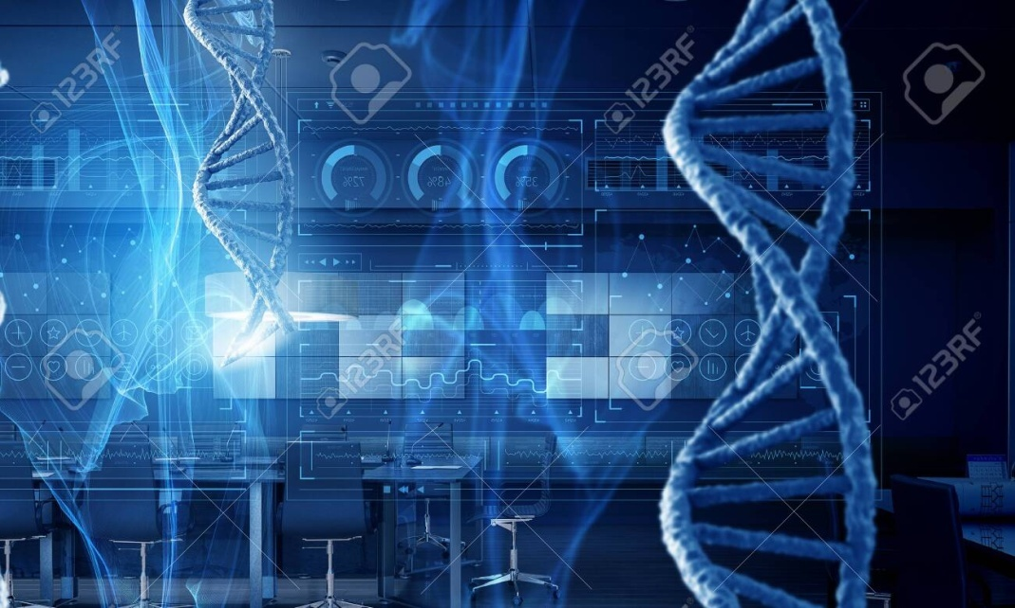
INTRODUCTION TO BIOTECHNOLOGY
Biotechnology occurred in two phase Traditional biotechnology and Modern biotechnology.
The combination of biology and production technology based on genetic engineering evolved into Modern biotechnology.
Modern biotechnology is based on two core techniques –
Genetic engineering and Chemical engineering.
Genetic engineering deals with alteration of genetic material while Chemical engineering deals with maintaining sterile environment for manufacturing of vaccines , antibodies , vitamins etc.
Biotechnology has vast applications.

